Slide 1
Food ORDER application
Notes:
This is my presentation for Assessment – App Implementation – of the CMP7163 (Advanced Mobile Computing Module)
I will talk about my app in the following steps:
I will REVIEW my original Design Idea – presented for assessment 1.1 – and comment on what has CHANGED
I will describe the overall STRUCTURE of my completed App implementation
I will describe and DEMONSTRATE the User Interface
I will give examples of the CODE behind the UI
I will give examples of the CODE used for Data Persistence on-device
I will give examples of the CODE used for accessing a Web Service for cloud based data
I will give examples of the CODE used to implement an Additional Framework feature in my App
I will give a conclusion describing the SUCCESSES and CHALLENGES of this Implementation effort

Slide 2
APPLICATION DESIGN/REVIEW
The aim was to design a prototype food order system for android and iOS platform. (cross platform).
User is able to view, find and buy food items and order them right there devices.
In my application user will also be able to perform action like order the food while adding it in to cart and provide payment details like COD and buy card details.
Notes:
The implementation follows the proposed design fairly closely – Accomplished the requirements of creating an cross platform application which
Provides the core features for finding and buying food items easily. However, features like tracking the food items or orders is not implemented.

Slide 3
APPLICATION FEATURE/FRAMEWORK
Web services: User should be able to search and data about different food items on the move e.g. through a web service and Json.
Data persistence: Search criteria will work on firebase and local cache system on their devices for future reference.
Product services: In my application I provide the facility of selecting product with different variation like quantity.
Cart services: In my application user will also be able to at the items in cart and perform checkout while adding address and payment information.
Notes:
Frameworks and Features which are essential to complete the prototype is covered in this where we try to cover all the aspects of web services
and data persistence via firebase where needed.

Slide 4
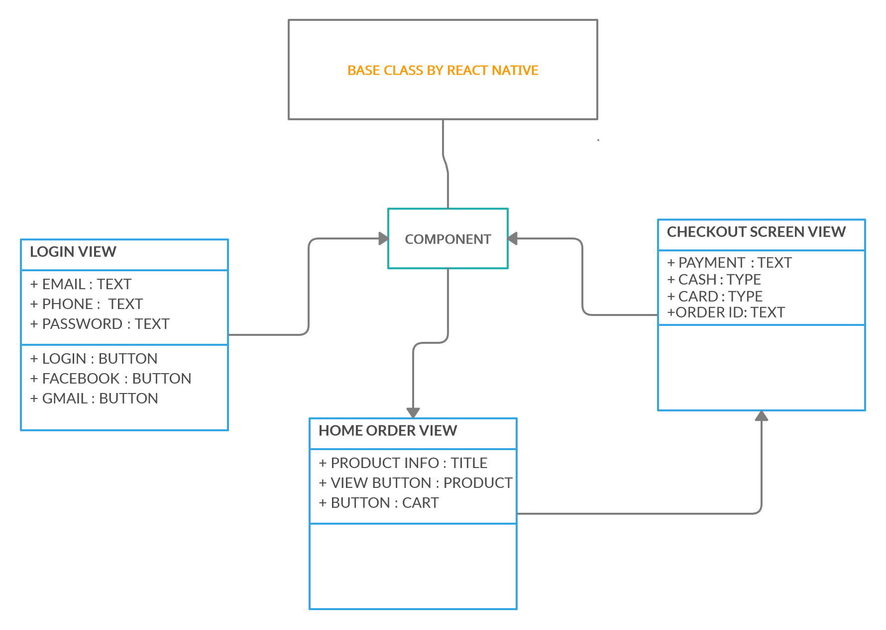
OVERALL APPLICATION STRUCTURE
Notes:
This slide describes the overall structure of the App:
There are 5 screens in the App – Login/Signup, Home, Food search, Item details, and Checkout Screen.
The Search screen is a core screen in that it contains the feature that allows you to search for food items by a keyword (search term). When search is performed the item
user entered will be retrieved as in Flat list.
The All category screen is used to maintain selected categories in device memory as in food items are sub-added. It is rendered when a user selects a single category on the screen. This screen also maintains state variables for a Item List retrieved from AsyncStorage, and whether it is still loading. The item which is loaded is passed as second call if search for an item is performed in previous search screen.
The Productinfo is the component that was created for use by all the lists within this app. It receives the items Size and quantity to be displayed as selection buttons.
The other screens (Home, Checkout) are for mainly for login in to the application and Checkout while ordering something from selected items.

Slide 5
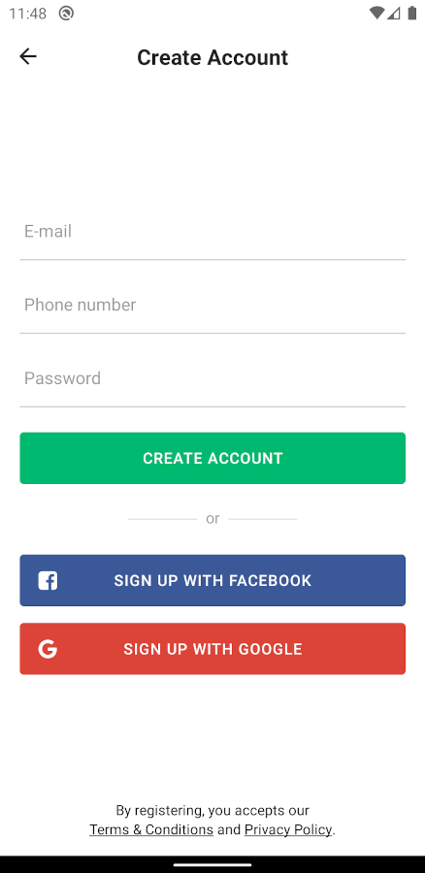
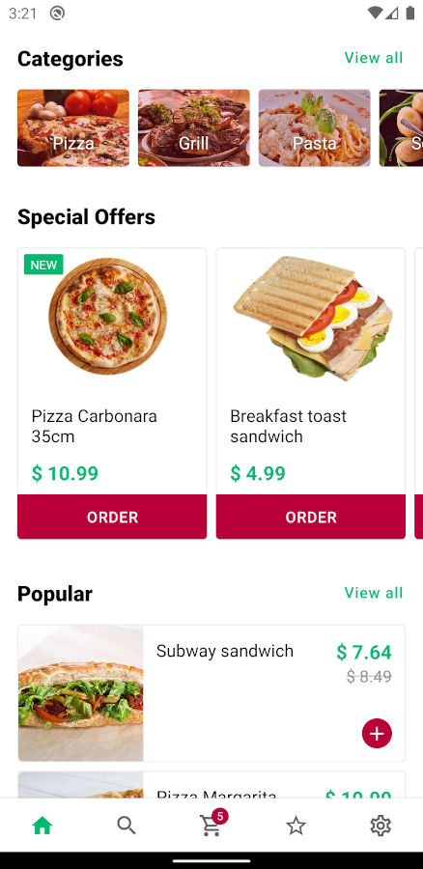
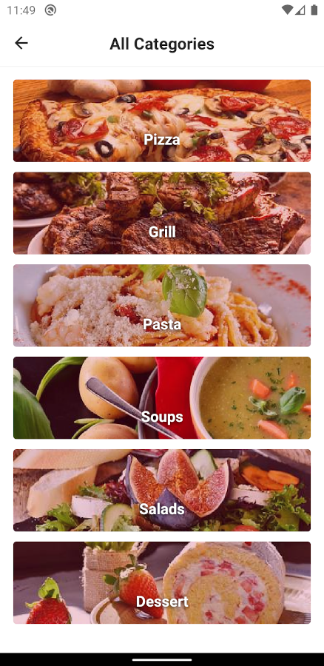
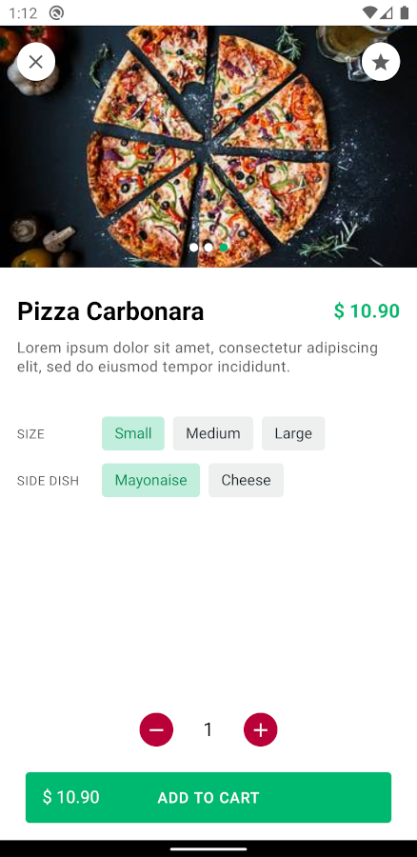
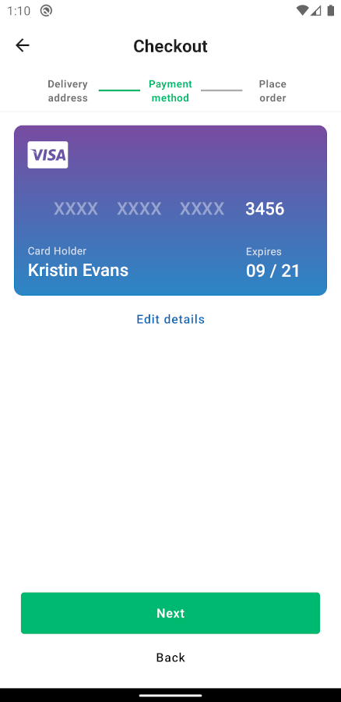
USER INTERFACE IMPLEMENTATION
Notes:
As described on the previous slide, the main screens are displayed here:
The Login screen is the entry point of the app UI and has three buttons to verify the authentications.
The Search screen starts with the list showing an Special offers list – by displaying a ’dummy’ list item . When the user enters a search term (keyword) and presses the search button (or taps the enter key) a search of the web service is conducted and any returned item is parsed and displayed in the list. If there are no matching the search term found in the database – the empty item remains displayed.
If the user presses and select order button item directly it can add item to cart if item doesn’t have variations to select.
If user search item from category it will redirect user to product info screen where user can read about item.
The Cart screen can also be invoked directly from the Home screen, to display a list of the previously added items (the saved data on device)
All screens are built on the React Navigation system – so allow navigation back and forth between screens elegantly.

Slide 6
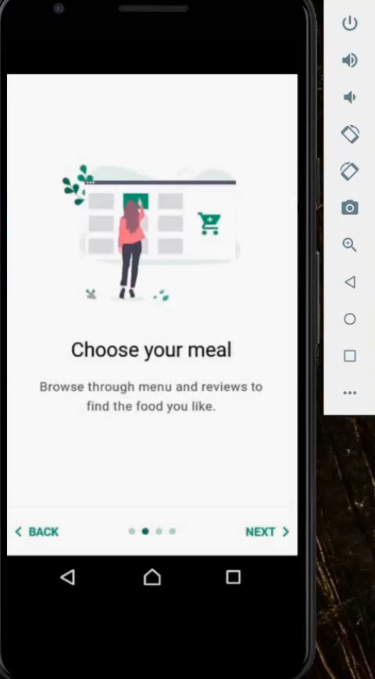
USER INTERFACE IMPLEMENTATION
Notes:
This slide shows a brief video demonstration of the App in action. Press play on the popup menu that appears…

Slide 7
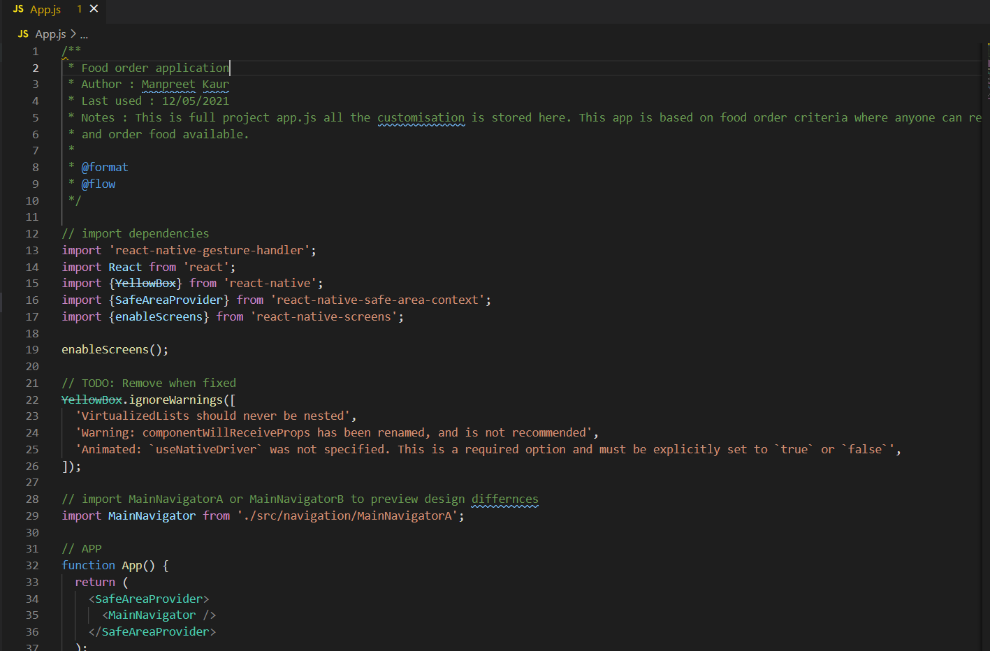
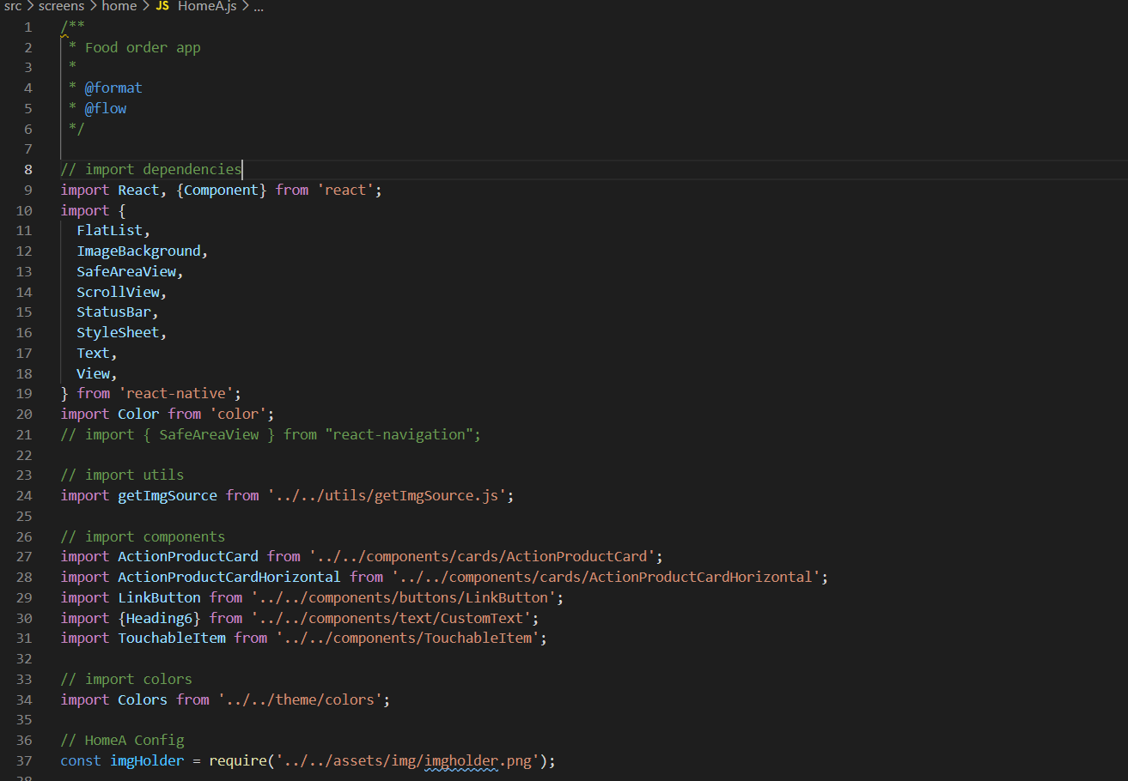
USER INTERFACE IMPLEMENTATION NAVIGATION CODE EXAMPLE
Notes:
As mentioned on the UI description slides, the App uses ‘react-navigation’ library to implement ‘stack’ type navigation between screens.
This is implemented in the App’s entry point - the App.js file.
The ‘Main Navigator’ function generates the stack object, that is then used in the ‘Navigation Container’ component to add screens to the stack.
It also indicates which screen is the startup screen of the App. Note that as all the screens are created as Components in separate JavaScript files – they need to be imported to this file.
If other screens need to access the navigation object, they must retrieve a reference to it through their props (all screens in the stack receive this prop).
This can be used to navigate further to other screens (as shown on the slide on the right – the Login screen navigating to the Home screen), or to access parameters passed between screens through the ‘Yellowbox’ prop of navigation (see the other UI code slides later on).

Slide 8
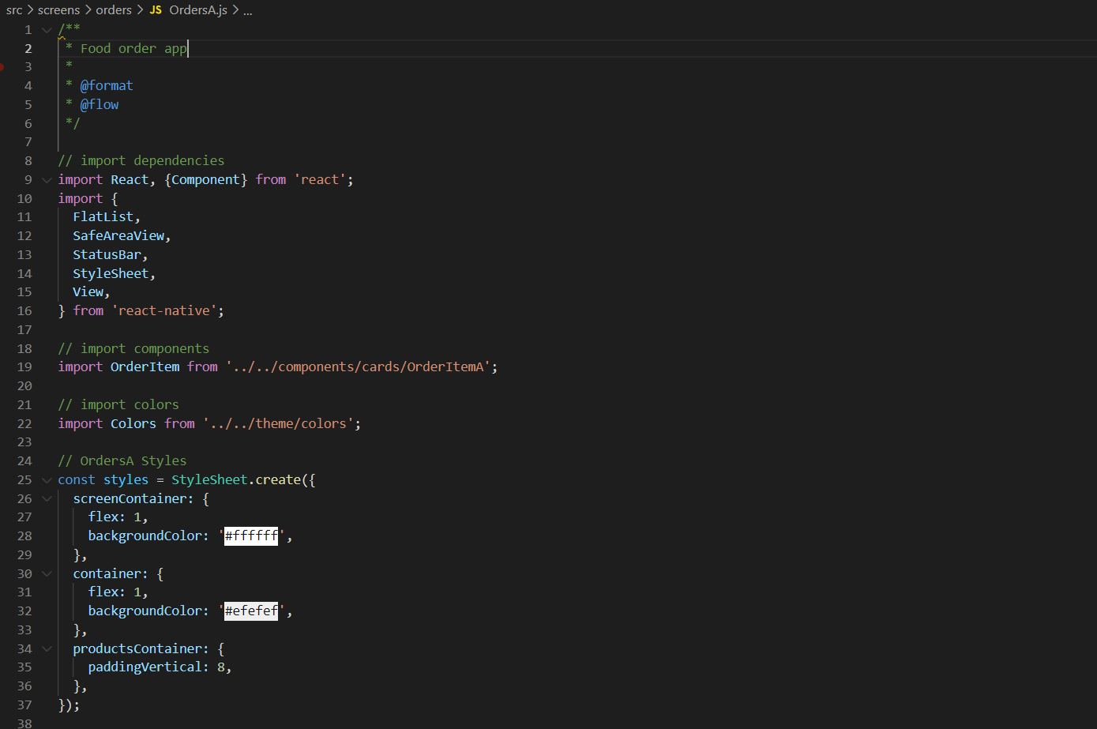
USER INTERFACE IMPLEMENTATION Data Persistence
Notes:
The Flat list, Safe are a view components are custom component that we have created to allow the food items displayed in a list to be re-used throughout the App.
It receives a food / dummy object for it’s data and a style string for it’s display style (color) – through its props.
The passed ‘yellow box’ prop is used to acquire the image from the Food item and product info of the item..

Slide 9
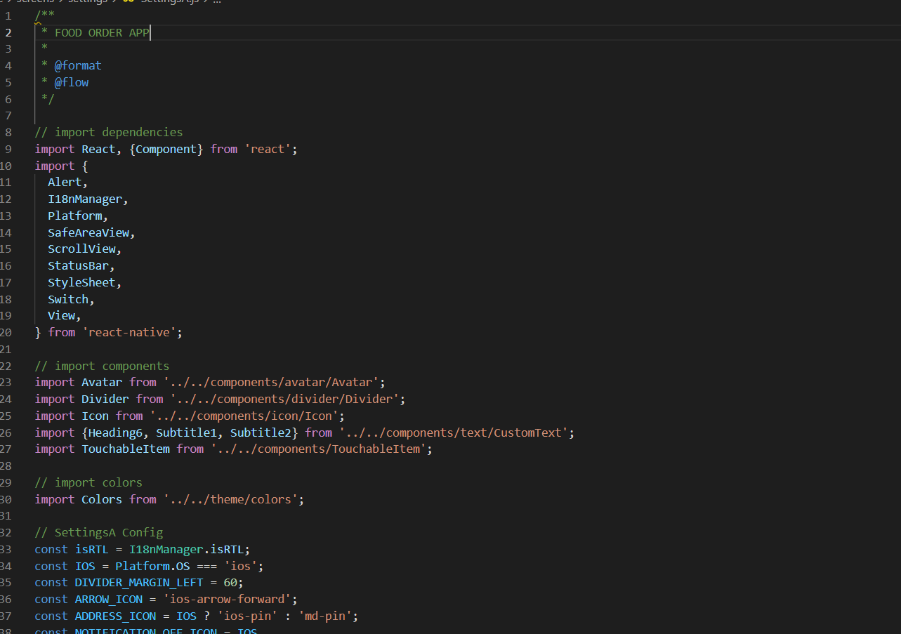
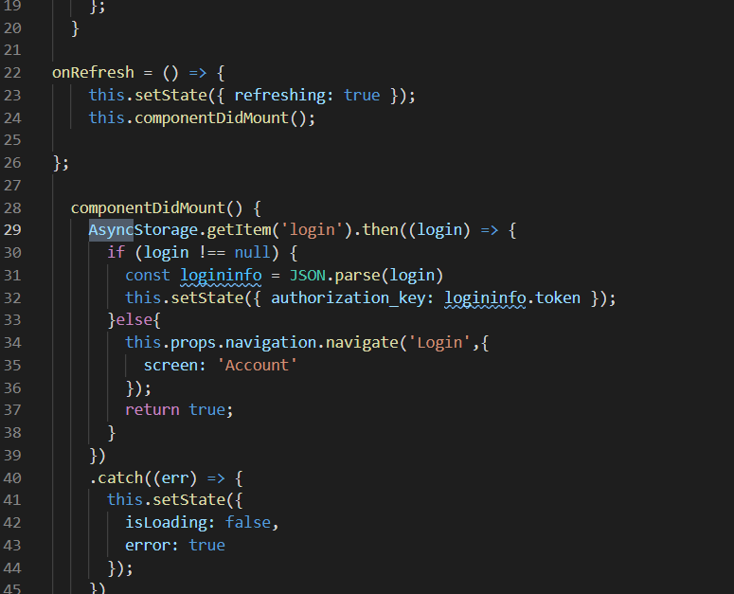
DATA PERSISTENCE IMPLEMENTATION
Notes:
The ‘AsyncStorage’ API of React Native was used to save, retrieve and delete movie objects in local on-device storage.
As it’s name indicates, it is an asynchronous mechanism (i.e. it run in parallel with other code) and this aspects has to be managed by our code.
To Login and save a user data – the ‘set state’ method is used, passing it the authorization key of user and its value as token.
To retrieve/read all the items in storage – we need to use a two step process. First we call the ‘getAllKeys’ method, this gives us an array of all the Keys in storage. Then, we pass that array of Keys to the ‘auth_key’ method to retrieve all the list items in storage. The records are returned as a 2 dimensional array of Key: Value pairs, we then need to iterate through the retrieved records to extract and operate on the values as required.

Slide 10
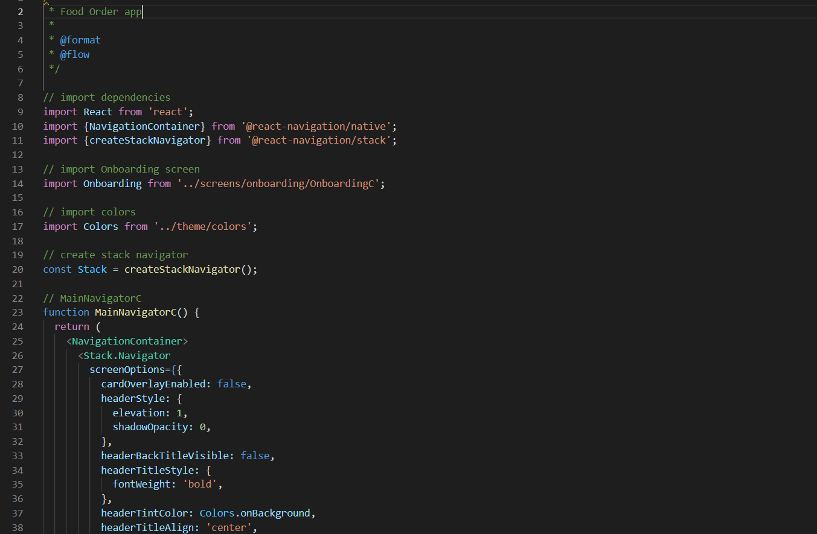
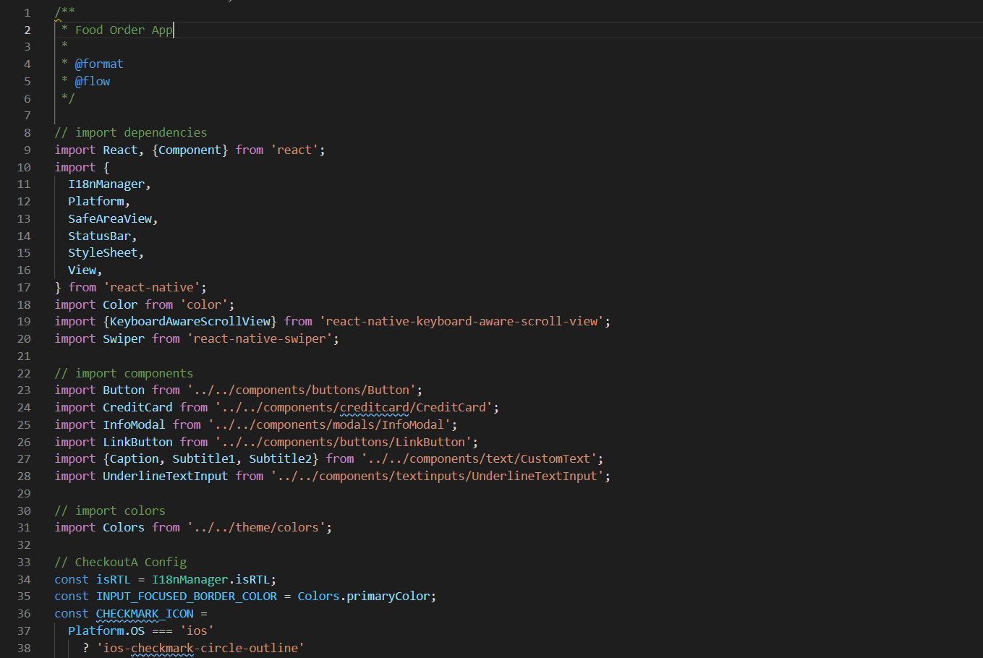
WEB SERVIES IMPLEMENTATION
Notes:
The React Native ‘Stack’ API is used for accessing the food item data Web Service in our App.
This is also an asynchronous API, so we need to deal with ’promises’ returned by calls – hence the ‘.then’ keywords (note: we could have also used ‘async’ / ‘await’ as before)
The const method accepts input as a String (which we construct based around the search term the user has entered in the example above (in the Search screen). It makes a GET call to the JSON service.
The returned response (example given on the right of the slide) then needs to be parsed into proper JSON format.
Finally we can extract the key(s) we need from it (for web searches – we need to extract the array of items redirected from cart to checkout screen as explained in example above.

Slide 11
ADDITIONAL FRAMEWORK/FEARTURE
In my application I have provided some generic configuration to globally handle settings like primary color, border radius, layout mode etc.
In my application I provide the connectivity with firebase and read the file with Jason web service implementation.
User has the facility to switch payment modes form COD to card or form card to COD.
After checkout user will also get order ID that saves locally on device.

Slide 12
CONCLUSION AND CHALLENGES
Project successfully completed for the following feature:
Created an easily navigable multi-screen UI.
Able to read and parse data successfully from web service.
Able to persist data on-device successfully.
User will able to perform checkout successfully.
User will able to add address successfully.
Project challenged on following aspects:
Not able to modify cloud / web service data as it was accessed from a public service.
Not able to add any additional framework due to time limitation.
Some aspects of UI could be improved in terms of look and feel.
Notes:
Finally, it can be said that a successful prototype was built based on the original design. The slide above describes the features that have been successfully implemented and which features were challenging or could have been improved.
Thank you!!

